Slide 1
November 21, 2024
SUDOKU
SOLVER
A Project by
Abhinav Bitragunta
Aman Gupta
Srinidhi Sai Boorgu
Ansh Jain

Slide 2
INITIAL STEPS
Regular backtracking, O(n) search time
Regular backtracking using hash arrays, O(1) search
Regular backtracking, hashing with bits.
Looking for faster algorithms...

Slide 3
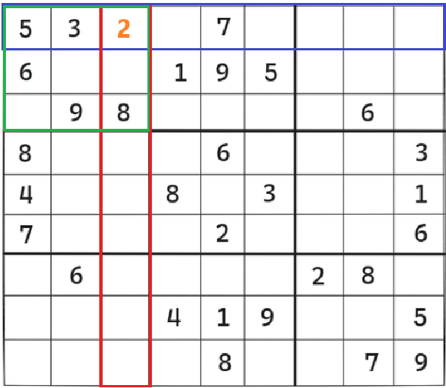

Slide 4
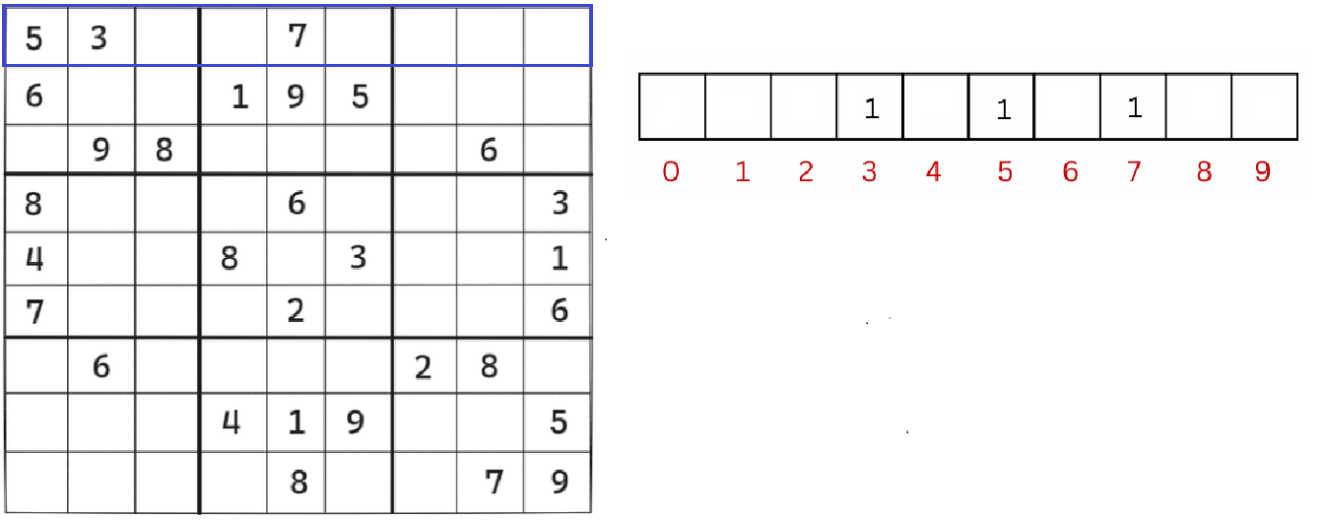
ARRAY HASHING

Slide 5
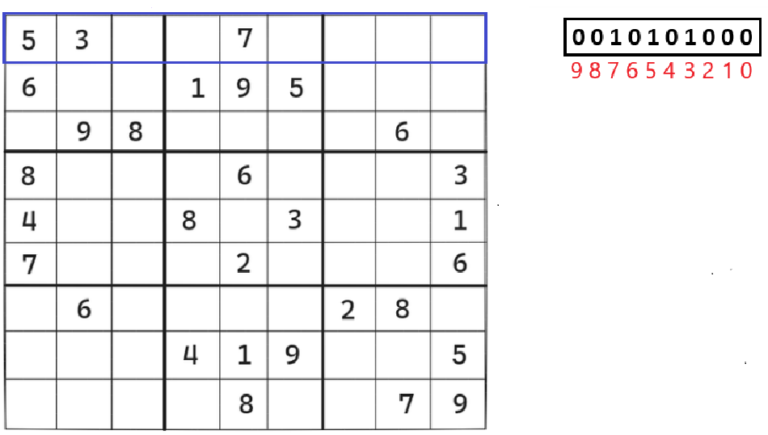
BIT HASHING

Slide 6
FASTER ALGORITHMS
Sudoku, being NP-complete, can be converted into other
NP-complete problems. There exist efficient algorithms such problems.
The exact cover problem is one such problem, and Donald Knuth’s ‘Algorithm X’ implemented using ‘Dancing Links’ is
a known efficient algorithm used to solve it.

Slide 7
THE EXACT COVER PROBLEM
Given a set S and another set where each element is a subset to S, is it possible to select a set of subsets such that every element in S exist in exactly one of the selected sets?

Slide 8
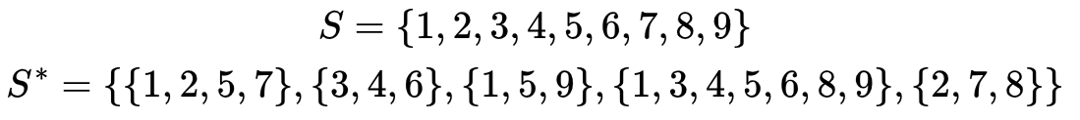
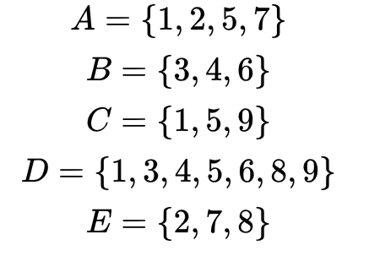

Slide 9
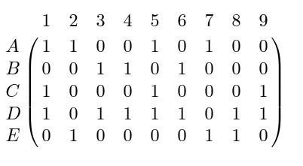
BINARY MATRIX REPRESENTATION

Slide 10
ALGORITHM X

Slide 11
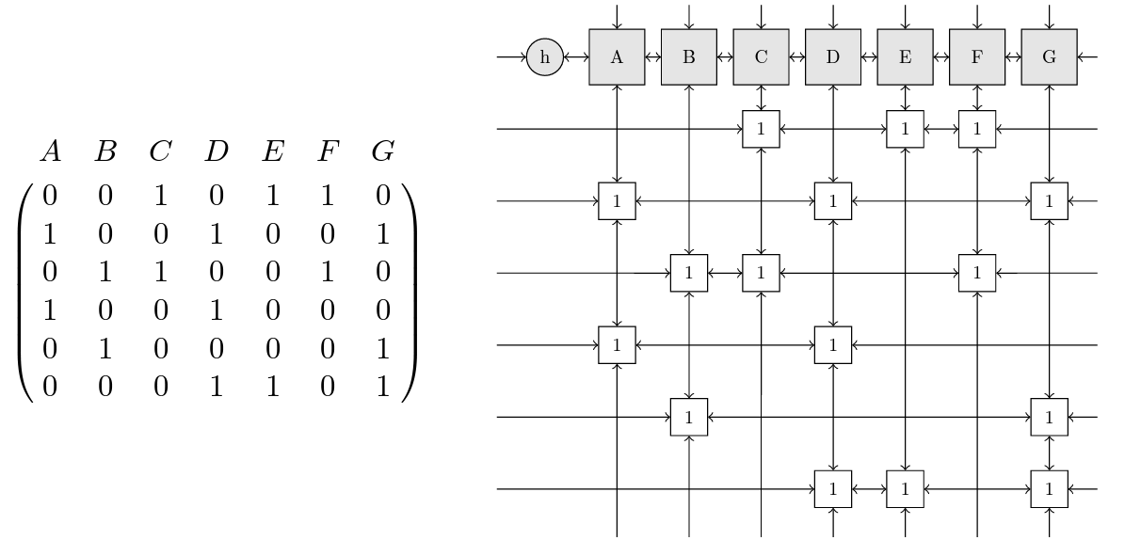
TOROIDAL LINKED LIST

Slide 12
EXACT COVER
Convert
Solve
Convert back
Convert Sudoku into the exact cover problem
Identify constraints and solve using Knuth’s DLX
Convert solution into solved Sudoku format

Slide 13
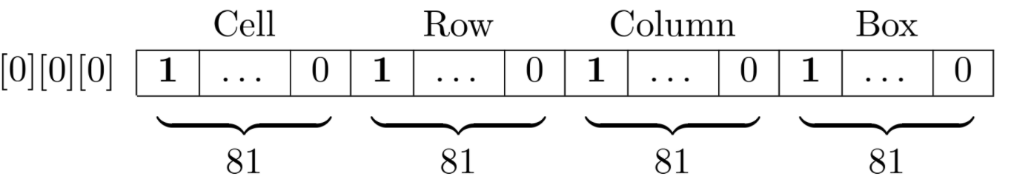
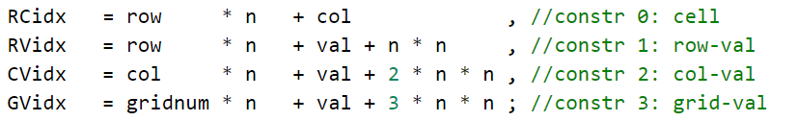
CONVERSION TO EXACT COVER
Represent a choice as [Row index][Column index][Value - 1]

Slide 14
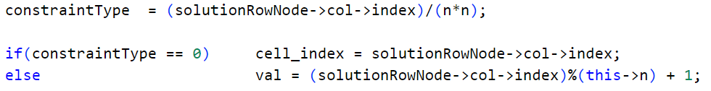
CONVERTING BACK TO SUDOKU

Slide 15
THANK
YOU

